Slide 1

British Airways
Customer ratings analysis and insights

Slide 2



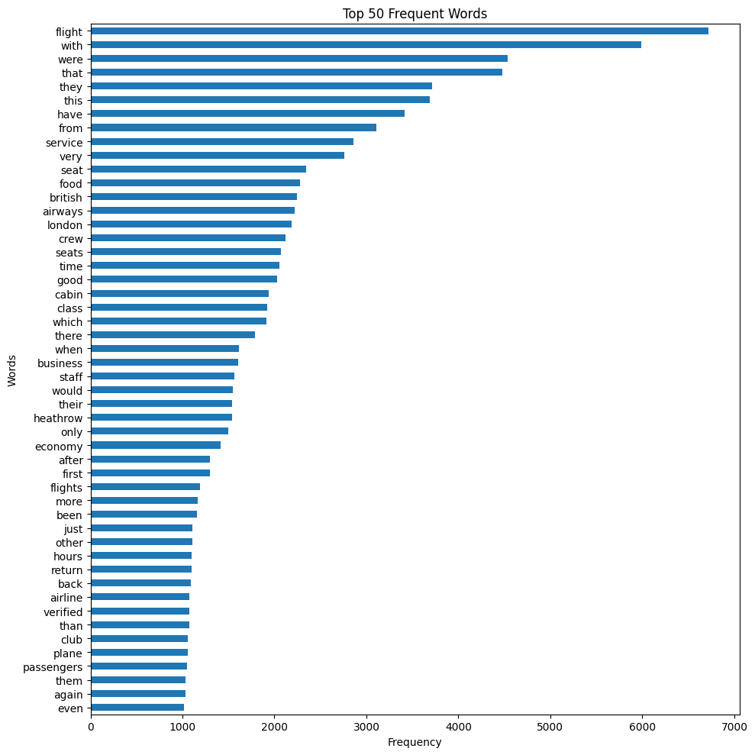
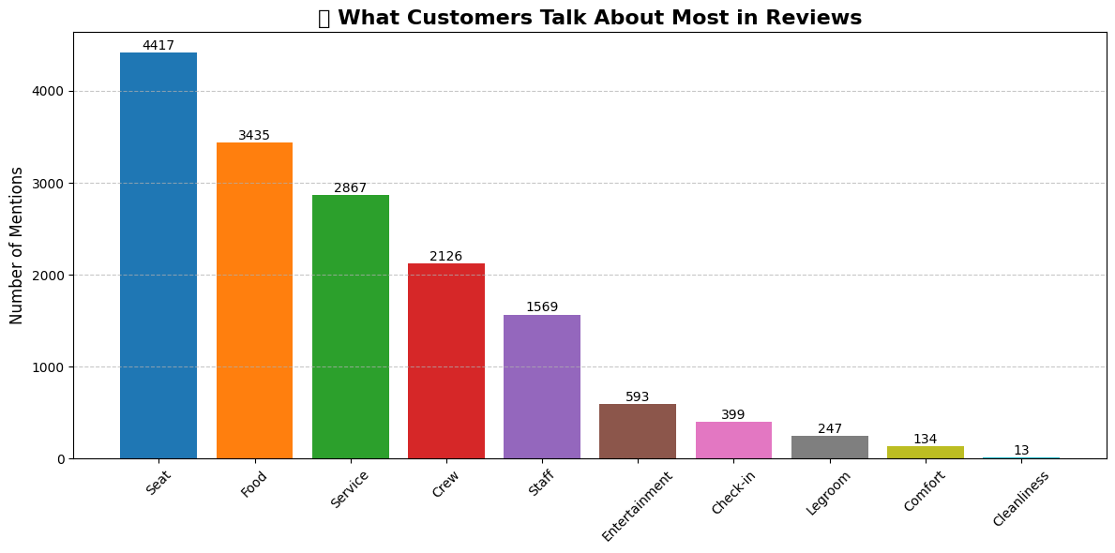
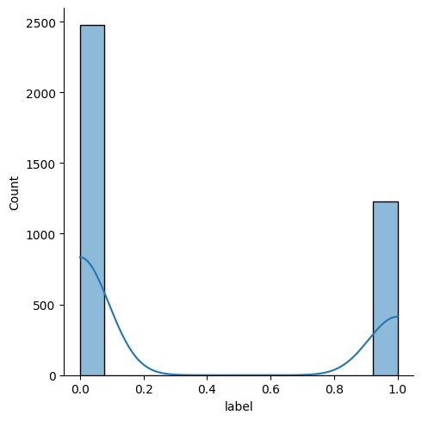
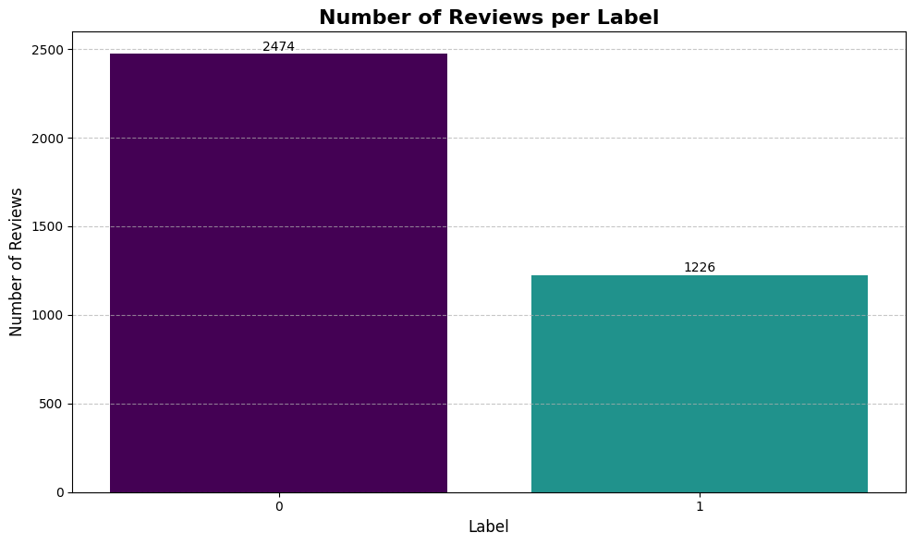
Key Metrics

Slide 3
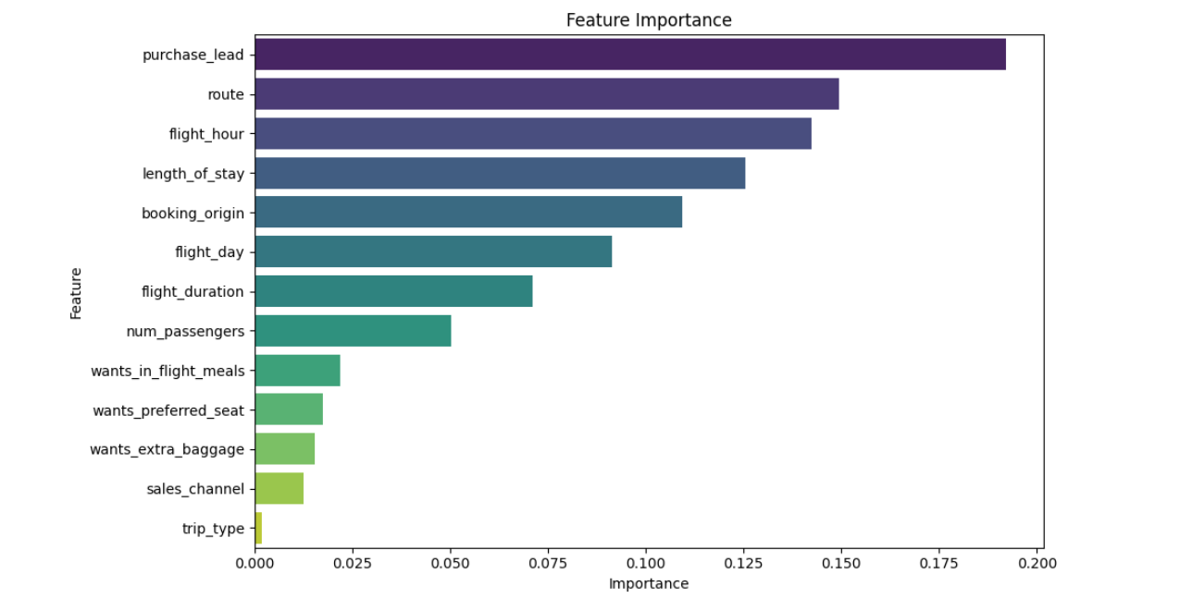
Feature Importance Analysis
1) purchase_lead had the highest influence on the model’s prediction, indicating that the timing of a customer's booking plays a critical role in determining booking completion.
2) route, flight_hour, and length_of_stay also showed strong predictive power.
3) These suggest that flight logistics and itinerary structure are closely tied to customer behavior.
4) Variables like trip_type, sales_channel, and extra service preferences had minimal impact.
5) Operational features (like booking lead time and route) outweigh customer service preferences in predicting booking outcomes.

